Slide 1


Decision Tree
Hossam Ahmed Salah
MSP Helwan

Slide 2



Agenda
Variance and Bias
Overfitting and Underfitting
Classification Decision Tree
Regression Decision Tree
Pruning a tree

Slide 3
Variance
Measurement of spread in the dataset
مقياس لتباعد النقاط المختلفة من النقطة الوسط
High Variance

Slide 4
Variance
Measurement of spread in the dataset
مقياس لتباعد النقاط المختلفة من النقطة الوسط
Low Variance

Slide 5
Bias Error
In statistics, bias refers to the tendency of a statistical estimator or method to consistently overestimate or underestimate a population parameter
tendency which causes differences between results and facts
Bias in ML is a sort of mistake in which some aspects of a dataset are given more weight and/or representation than others
In ML bias inability to capture the underlying complexity of the data.

Slide 6

Overfitting and underfitting

Slide 7
Considering we have this data, and we want to train a 2 models

Slide 8
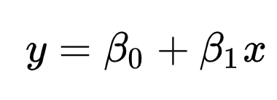
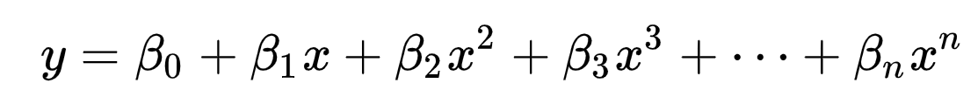
Models
Linear
Polynomial

Slide 9
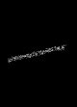
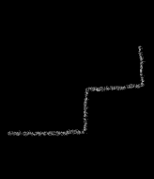
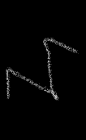
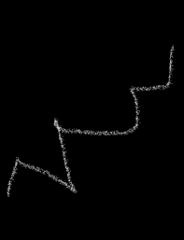
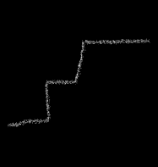

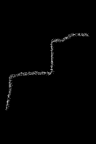
Considering we have this data, and we want to train a 2 models

Slide 10
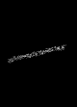

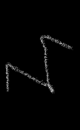
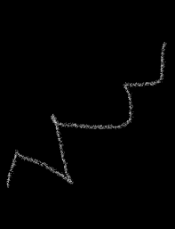

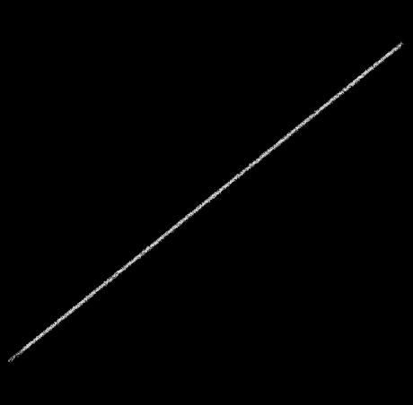

Only fit few points
Perfect fit of the trained data 100%

Slide 11
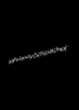
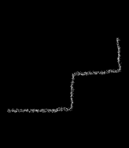

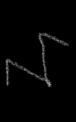

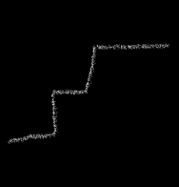
So, you decided now to deploy your perfect model on the real world

Slide 12
So, a lot of data inputted to your model
Your model is terrible on real data not near even
Seeking perfection in train set lead to high variance model
This called overfitting

Slide 13
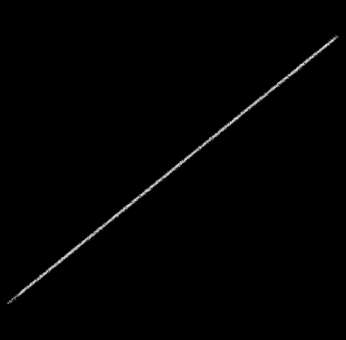
What about the linear Model
Terrible model but we the training error and testing error is not too far
If average error is 20% for each point you can say that new points can be + or – 20%
This model has a high bias following the line doesn’t care about the data
This model underfit the data too simple to model it

Slide 14
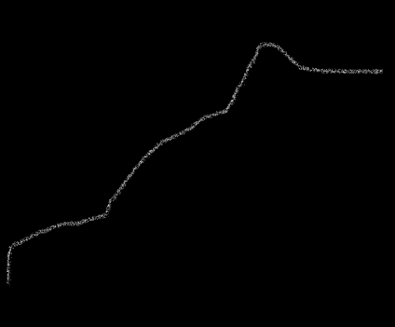
We need a mode that generalize
we shall tolerant some bias (error) in the training set
That mean making this model has less variance
It’s to simplify the model
We have errors in the training set
But we can have less error when dealing with new input
A Best fit trying to achieve balance between Bias(error, simplicity) and Variance (complexity)
It’s a tradeoff

Slide 15
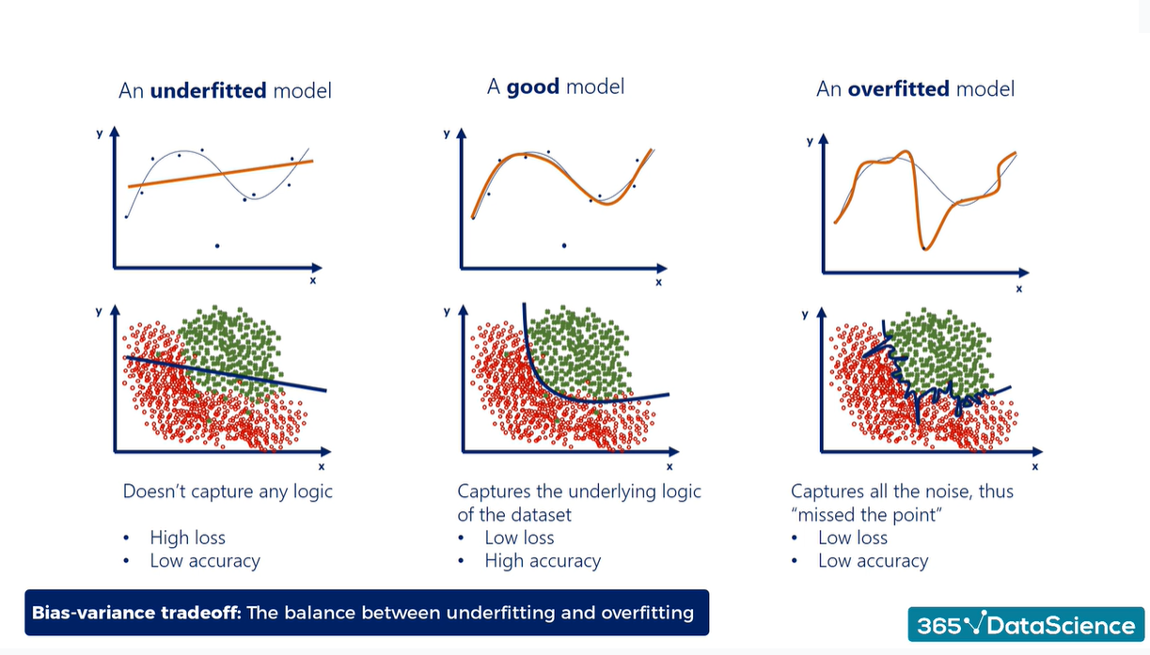

Slide 16
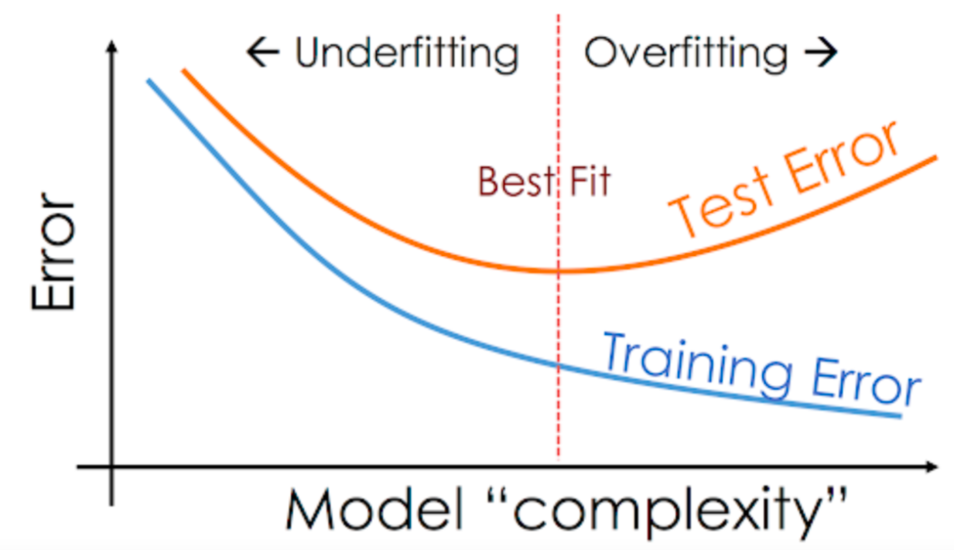

Slide 17

Classification Decision Tree

Slide 18
#10
Circle# | color | r
1 | R | 1
2 | R | 3
3 | G | 4
4 | G | 5
5 | G | 6
6 | R | 7
7 | R | 7
8 | R | 1
9 | R | 3
10 | G | 8
#6
#7
#5
#1
#2
#9
#8
#3
#4

Slide 19
Is you color RED?
NO
YES
#10
#7
#6
#9
#5
#1
#3
#8
#2
#4

Slide 20
We were a little bit lucky 🍀? Choosing color was the best to separate the circles
NO
YES
Circle# | color | r
1 | R | 1
2 | R | 3
3 | G | 4
4 | G | 5
5 | G | 6
6 | R | 7
7 | R | 7
8 | R | 1
9 | R | 3
10 | G | 8
#10
#7
#6
#9
#5
#1
#3
#8
#2
#4

Slide 21
What if we tried to split with r based on threshold 3.65
Is r > 3.65?
Circle# | color | r
1 | R | 1
2 | R | 3
3 | G | 4
4 | G | 5
5 | G | 6
6 | R | 7
7 | R | 7
8 | R | 1
9 | R | 3
10 | G | 8
#2
YES
NO
#3
#10
#1
#8
#5
#9
#6
#4
#7

Slide 22
Is r > 3.65?
#5
Left side of the tree >3.65
#3
#10
#4
YES
#3
#10
#5
Is you color RED?
#6
#4
#7
#6
#7

Slide 23
Is r > 3.65?
right side of the tree <=3.65
#2
NO
#1
#8
#9

Slide 24
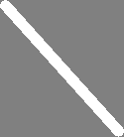
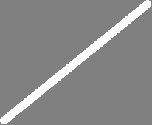
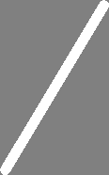
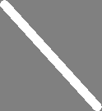
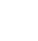
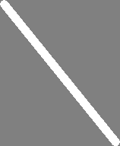
Is you color RED?
Is r > 3.65?
R
R
G
Is you color RED?
G
R

Slide 25
From this simple example we see that the splitting column can affect the tree size , so selecting the best feature to split is the challenge in DTs
Also, we can notice that the best feature to split is the one that give us more pure nodes
We can see that here simply because we have 2 colors only but what if we got three colors or more classes in each feature
Entropy and Gini index two ways decide how to split , by selecting the split give us purest nodes as possible

Slide 26
DT features and notes
Decision trees use a top-down approach called recursive binary splitting.
Recursive binary splitting starts at the top of the tree and splits the predictor space into two branches.
The algorithm is greedy because it selects the best split at each step, without considering future splits.
The algorithm evaluates variables based on statistical criteria to choose the variable that performs best. {Entropy , Gini index}
The predictor space is divided into two branches at each split, creating a hierarchical structure.
The algorithm does not project forward to optimize the entire tree, but rather focuses on the current step.

Slide 27
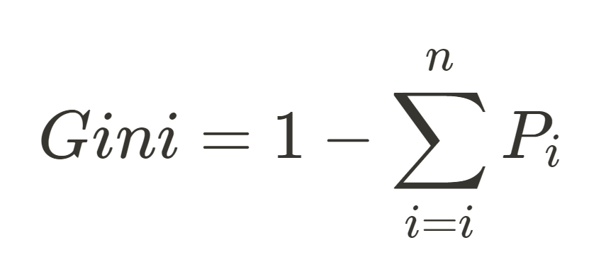
Gini index
The Gini Index measures the probability of misclassification for a randomly chosen instance.
A lower Gini Index indicates a better split with a lower likelihood of misclassification.
The Gini Index approach focuses on measuring impurity
The Gini Index ranges from 0 (highest purity) to 0.5 (random assignment of classes).
To calculate the Gini Index for a node, the Gini Index is calculated for each sub node, and then a weighted average is taken to determine the overall Gini Index for the node

Slide 28
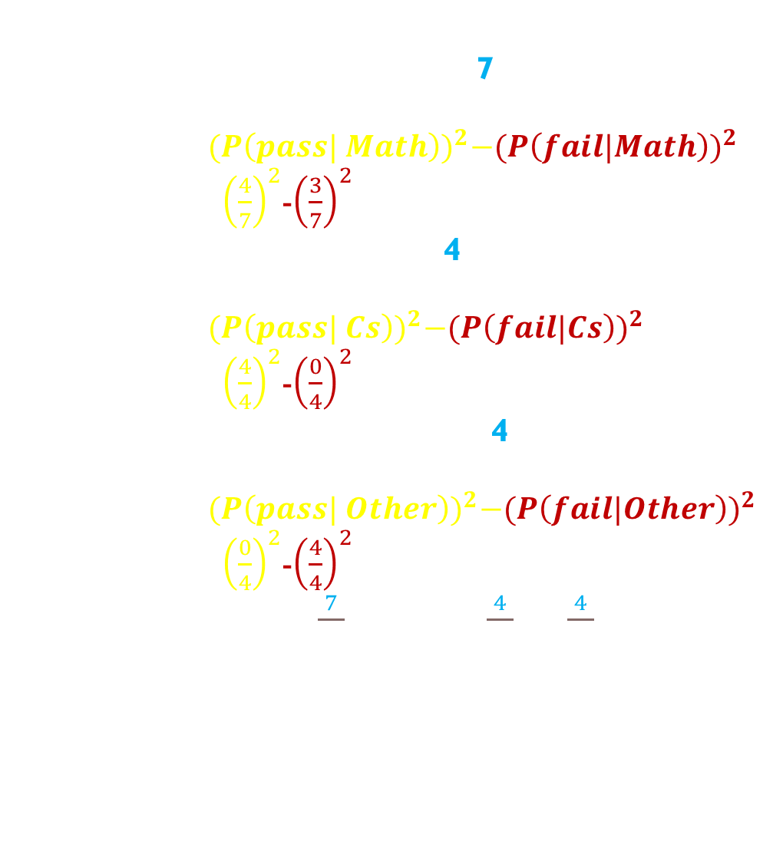
Gini index
the root node : Student Background
# | Result | Other online courses | Background | Working
1 | Pass | y | Math | NW
2 | Fail | n | Math | W
3 | Fail | y | Math | W
4 | Pass | y | Cs | NW
5 | Fail | n | Other | W
6 | Fail | y | Other | W
7 | Pass | y | Math | NW
8 | Pass | y | Cs | NW
9 | Pass | n | Math | W
10 | Pass | n | Cs | W
11 | Pass | y | Cs | W
12 | Pass | n | Math | NW
13 | Fail | y | Other | W
14 | Fail | n | Other | NW
15 | Fail | n | Math | W
Calculate Gini index for each sub node
Math (total observation 7)
4 pass, 3 fail
1 -${(P\left(pass| Math\right))}^{2}−{(P\left(fail|Math\right))}^{2}$
1 – ${\left(\frac{4}{7}\right)}^{2}$-${\left(\frac{3}{7}\right)}^{2}$ = 0.48979
CS (total observation 4)
4 pass, 0 fail
1 -${(P\left(pass| Cs\right))}^{2}−{(P\left(fail|Cs\right))}^{2}$
1 – ${\left(\frac{4}{4}\right)}^{2}$-${\left(\frac{0}{4}\right)}^{2}$ = 0 🌟
Other (total observation 4)
0 pass, 1 fail
1 -${(P\left(pass| Other\right))}^{2}−{(P\left(fail|Other\right))}^{2}$
1 – ${\left(\frac{0}{4}\right)}^{2}$-${\left(\frac{4}{4}\right)}^{2}$ = 0 🌟
${\text{Gini}}_{background}$ = $\frac{7}{15}$×0.48979+$\frac{4}{15}$×0+$\frac{4}{15}$×0 = 0.22857

Slide 29
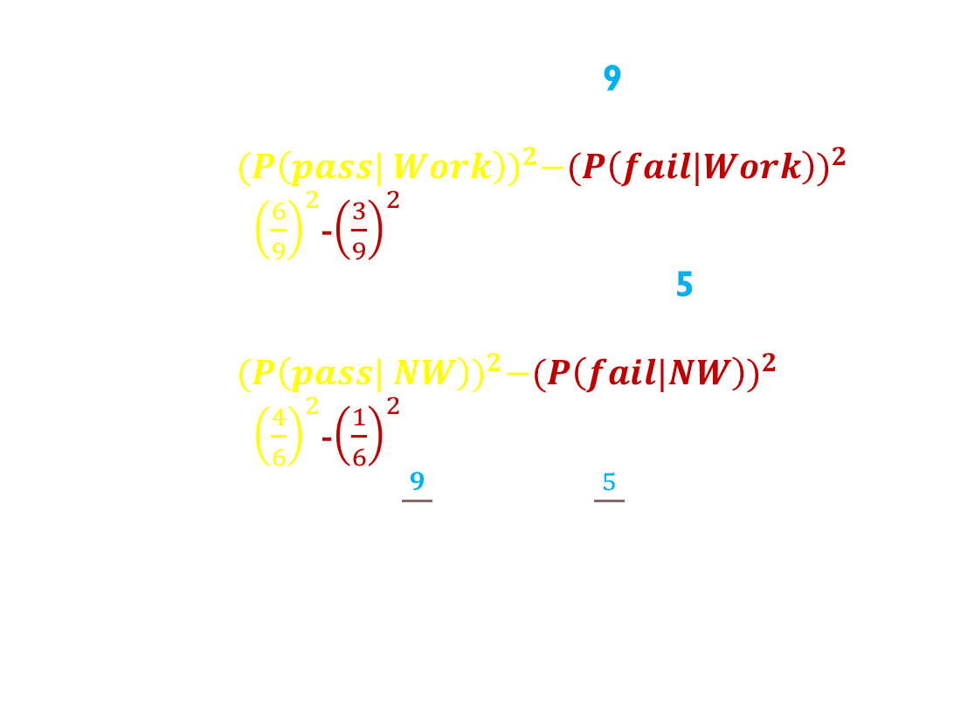
Gini index
the root node :Working status
# | Result | Other online courses | Background | Working
1 | Pass | y | Math | NW
2 | Fail | n | Math | W
3 | Fail | y | Math | W
4 | Pass | y | Cs | NW
5 | Fail | n | Other | W
6 | Fail | y | Other | W
7 | Pass | y | Math | NW
8 | Pass | y | Cs | NW
9 | Pass | n | Math | W
10 | Pass | n | Cs | W
11 | Pass | y | Cs | W
12 | Pass | n | Math | NW
13 | Fail | y | Other | W
14 | Fail | n | Other | NW
15 | Fail | n | Math | W
Calculate Gini index for each sub node
Working (total observation 9)
6 pass, 3 fail
1 -${(P\left(pass| Work\right))}^{2}−{(P\left(fail|Work\right))}^{2}$
1 – ${\left(\frac{6}{9}\right)}^{2}$-${\left(\frac{3}{9}\right)}^{2}$ = 0.44444
Not Working (total observation 5)
4 pass, 1 fail
1 -${(P\left(pass| NW\right))}^{2}−{(P\left(fail|NW\right))}^{2}$
1 – ${\left(\frac{4}{6}\right)}^{2}$-${\left(\frac{1}{6}\right)}^{2}$ = 0.52778
${\text{Gini}}_{WorkingStatus}$ = $\frac{9}{15}$×0.44444+$\frac{5}{15}$×0.52778= 0.44259

Slide 30
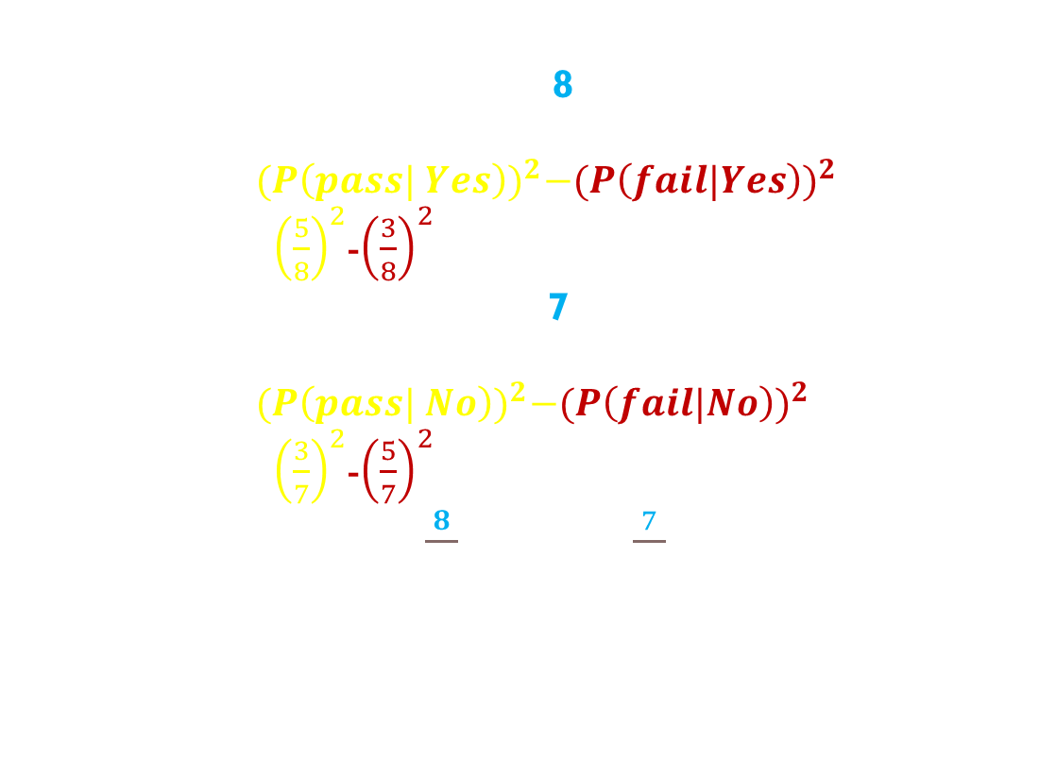
Gini index
the root node :Other online courses
# | Result | Other online courses | Background | Working
1 | Pass | y | Math | NW
2 | Fail | n | Math | W
3 | Fail | y | Math | W
4 | Pass | y | Cs | NW
5 | Fail | n | Other | W
6 | Fail | y | Other | W
7 | Pass | y | Math | NW
8 | Pass | y | Cs | NW
9 | Pass | n | Math | W
10 | Pass | n | Cs | W
11 | Pass | y | Cs | W
12 | Pass | n | Math | NW
13 | Fail | y | Other | W
14 | Fail | n | Other | NW
15 | Fail | n | Math | W
Calculate Gini index for each sub node
Yes (total observation 8)
5 pass, 3 fail
1 -${(P\left(pass| Yes\right))}^{2}−{(P\left(fail|Yes\right))}^{2}$
1 – ${\left(\frac{5}{8}\right)}^{2}$-${\left(\frac{3}{8}\right)}^{2}$ = 0.46875
No (total observation 7)
3 pass, 4 fail
1 -${(P\left(pass| No\right))}^{2}−{(P\left(fail|No\right))}^{2}$
1 – ${\left(\frac{3}{7}\right)}^{2}$-${\left(\frac{5}{7}\right)}^{2}$ = 0.48798
${\text{Gini}}_{OnlineCourses}$ = $\frac{8}{15}$×0.46875+$\frac{7}{15}$×0.48798= 0.47825

Slide 31
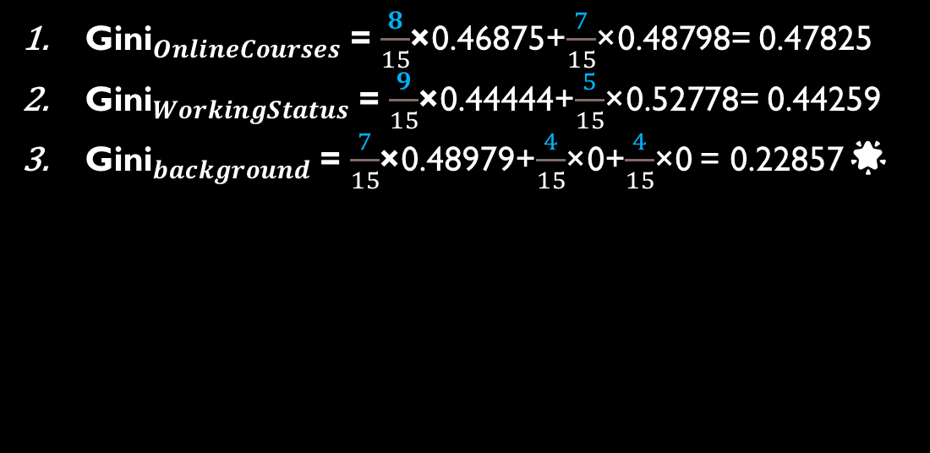
Gini index
# | Result | Other online courses | Background | Working
1 | Pass | y | Math | NW
2 | Fail | n | Math | W
3 | Fail | y | Math | W
4 | Pass | y | Cs | NW
5 | Fail | n | Other | W
6 | Fail | y | Other | W
7 | Pass | y | Math | NW
8 | Pass | y | Cs | NW
9 | Pass | n | Math | W
10 | Pass | n | Cs | W
11 | Pass | y | Cs | W
12 | Pass | n | Math | NW
13 | Fail | y | Other | W
14 | Fail | n | Other | NW
15 | Fail | n | Math | W
${\text{Gini}}_{OnlineCourses}$ = $\frac{8}{15}$×0.46875+$\frac{7}{15}$×0.48798= 0.47825
${\text{Gini}}_{WorkingStatus}$ = $\frac{9}{15}$×0.44444+$\frac{5}{15}$×0.52778= 0.44259
${\text{Gini}}_{background}$ = $\frac{7}{15}$×0.48979+$\frac{4}{15}$×0+$\frac{4}{15}$×0 = 0.22857🌟
Background
Cs
Not cs
Math
Other
fail
pass
Working?
N
W
Online y
Online N
Online y
Pass
Fail
Pass
Fail
Pass
Fail
Online N
Pass
Fail

Slide 32
Gini index
We may not get all leaves pure single class pass/fail , maybe tree terminated with heterogeneous classes here we may classify based on the majority class in the leaf
Background
Cs
Not cs
Math
Other
fail
pass
Working?
N
W
Online y
Online N
Online y
Online N

Slide 33
Gini index
A full decision tree is a tree that is grown until all the terminal nodes (i.e., the leaves) contain a minimum number of observations, or until all the observations in the training set belong to the same class. However, even if a decision tree is grown to its maximum depth, there may still be some leaves that are not pure if the algorithm determines that further splitting of the data would not significantly improve the classification accuracy

Slide 34
Entropy
In information theory, the entropy of a random variable is the average level of “information”, “surprise”, or “uncertainty” inherent to the variable’s possible outcome
It is often associated with a state of disorder, randomness, or uncertainty.
Entropy in Decision Trees is a measure of disorder or impurity in a node.
Nodes with a more diverse composition have higher entropy than nodes with a single category.
Entropy ranges from 0 to 1, with 0 representing minimum entropy (pure node) and 1 representing maximum entropy (high disorder).
Entropy helps determine the homogeneity or purity of a node in Decision Trees.

Slide 35
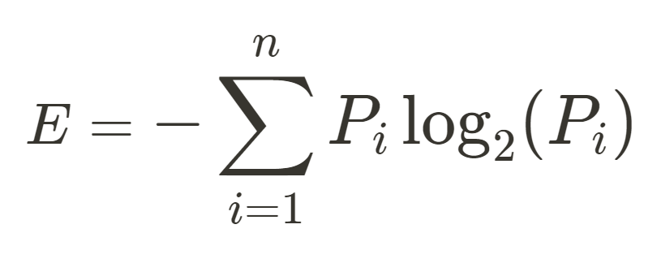
Entropy
Information Gain measures the amount of information a feature provides for predicting the target variable.

Slide 36
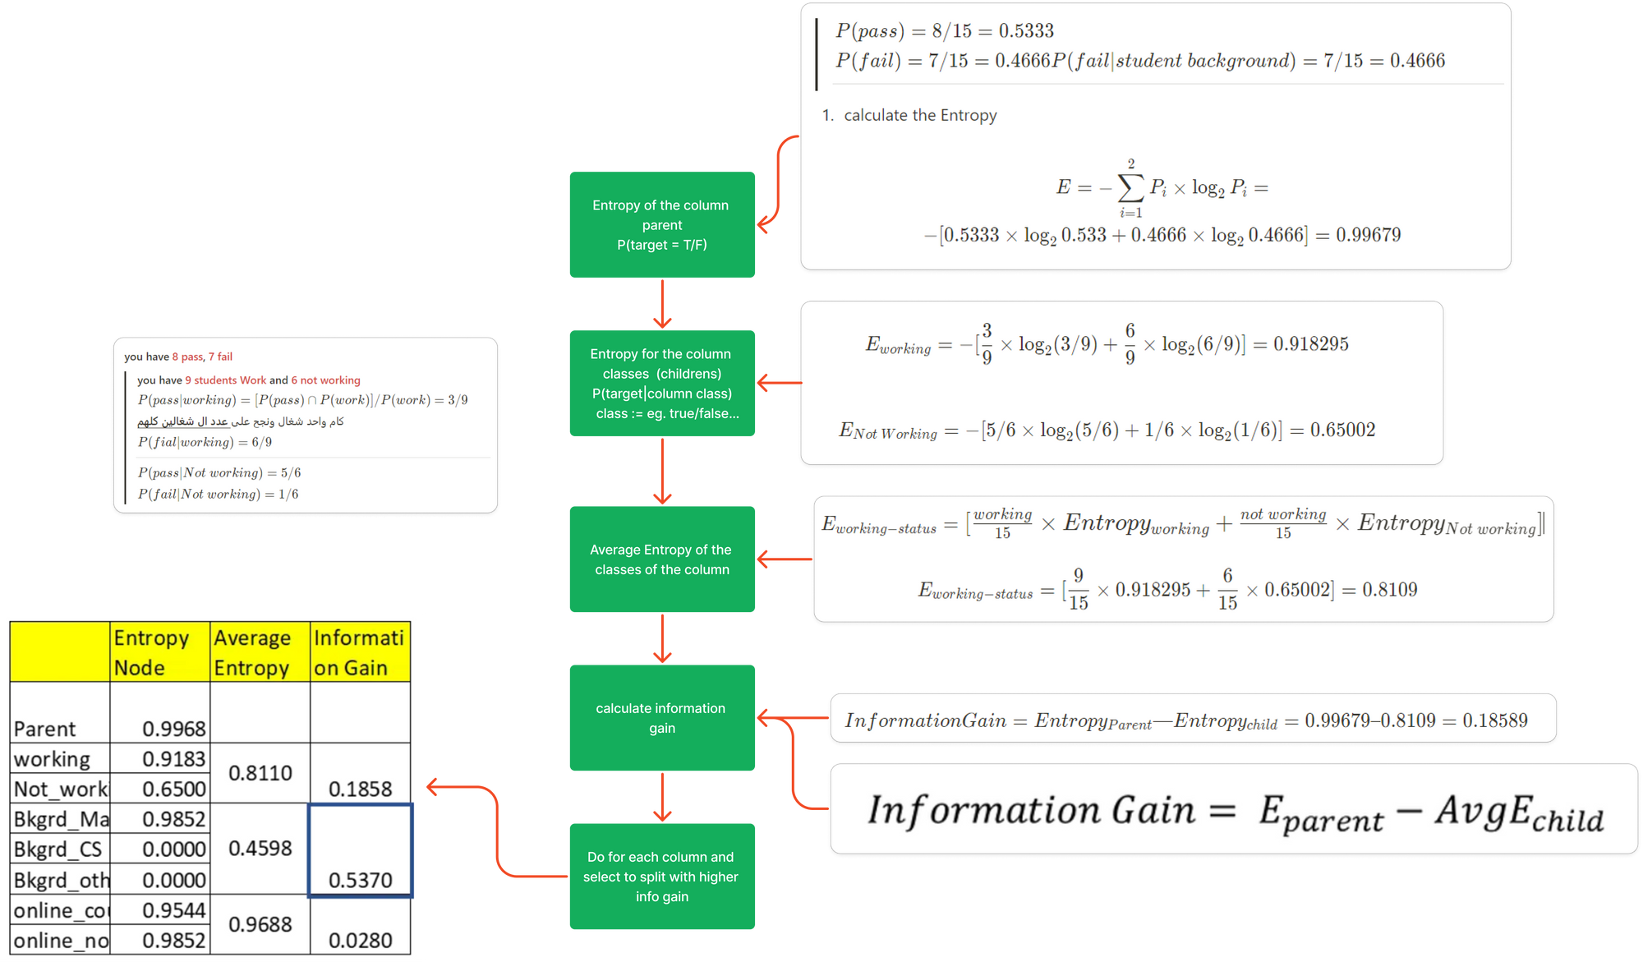
Entropy

Slide 37

Regression Decision tree

Slide 38
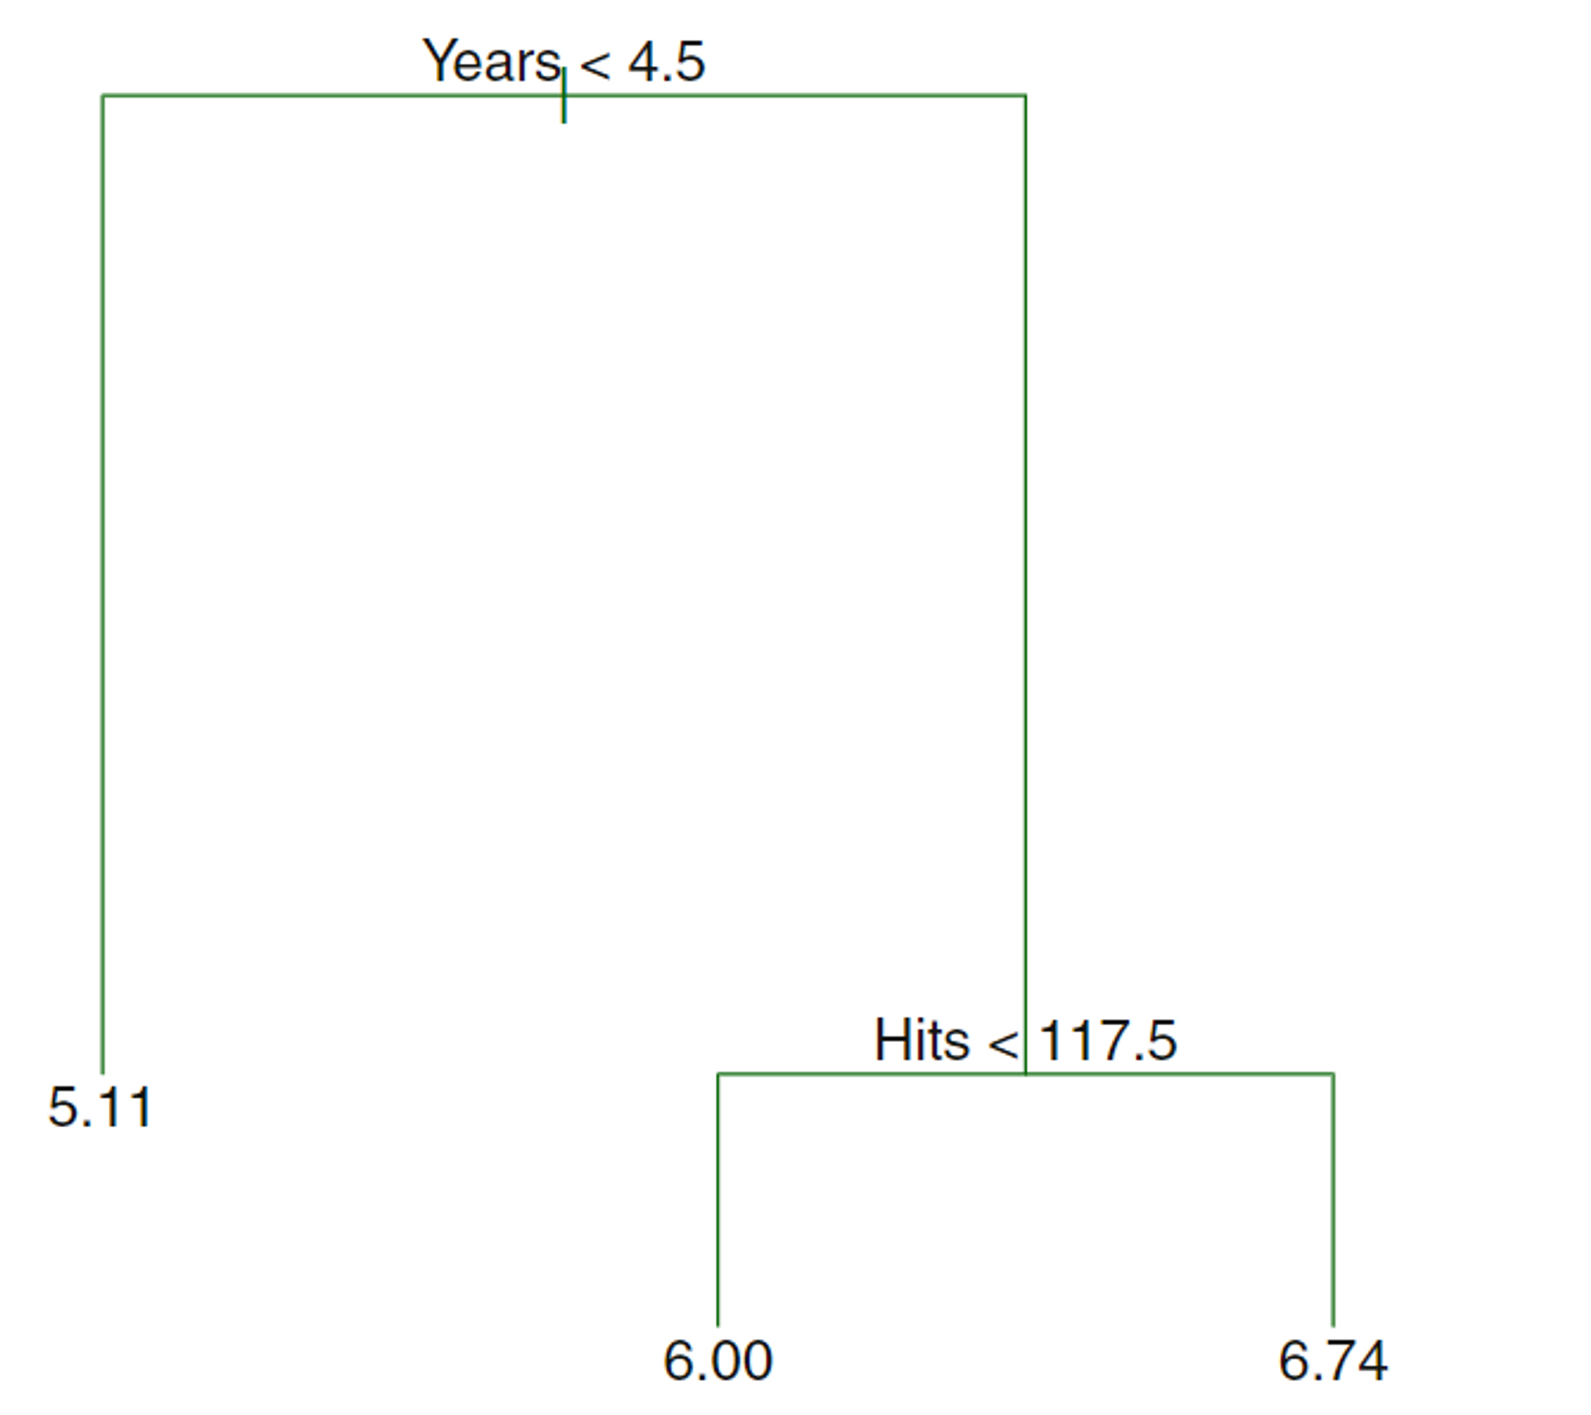

Baseball

Slide 39
The regression tree predicts the log salary of baseball players based on two predictor variables: years played, and hits made the previous year.
The first split is on the Years variable, splitting players into those with less than 4.5 years played versus 4.5 or more years played.
The second split is on the Hits variable, further splitting the two branches based on a threshold on hits made.
There are three terminal nodes or leaves, indicating the final predicted values for log salary. The number in each leaf node is the mean log salary for that group of players.
The tree performs splits by choosing the predictor and threshold that results in the most homogeneous groups in terms of the response variable (log salary)
Baseball

Slide 40
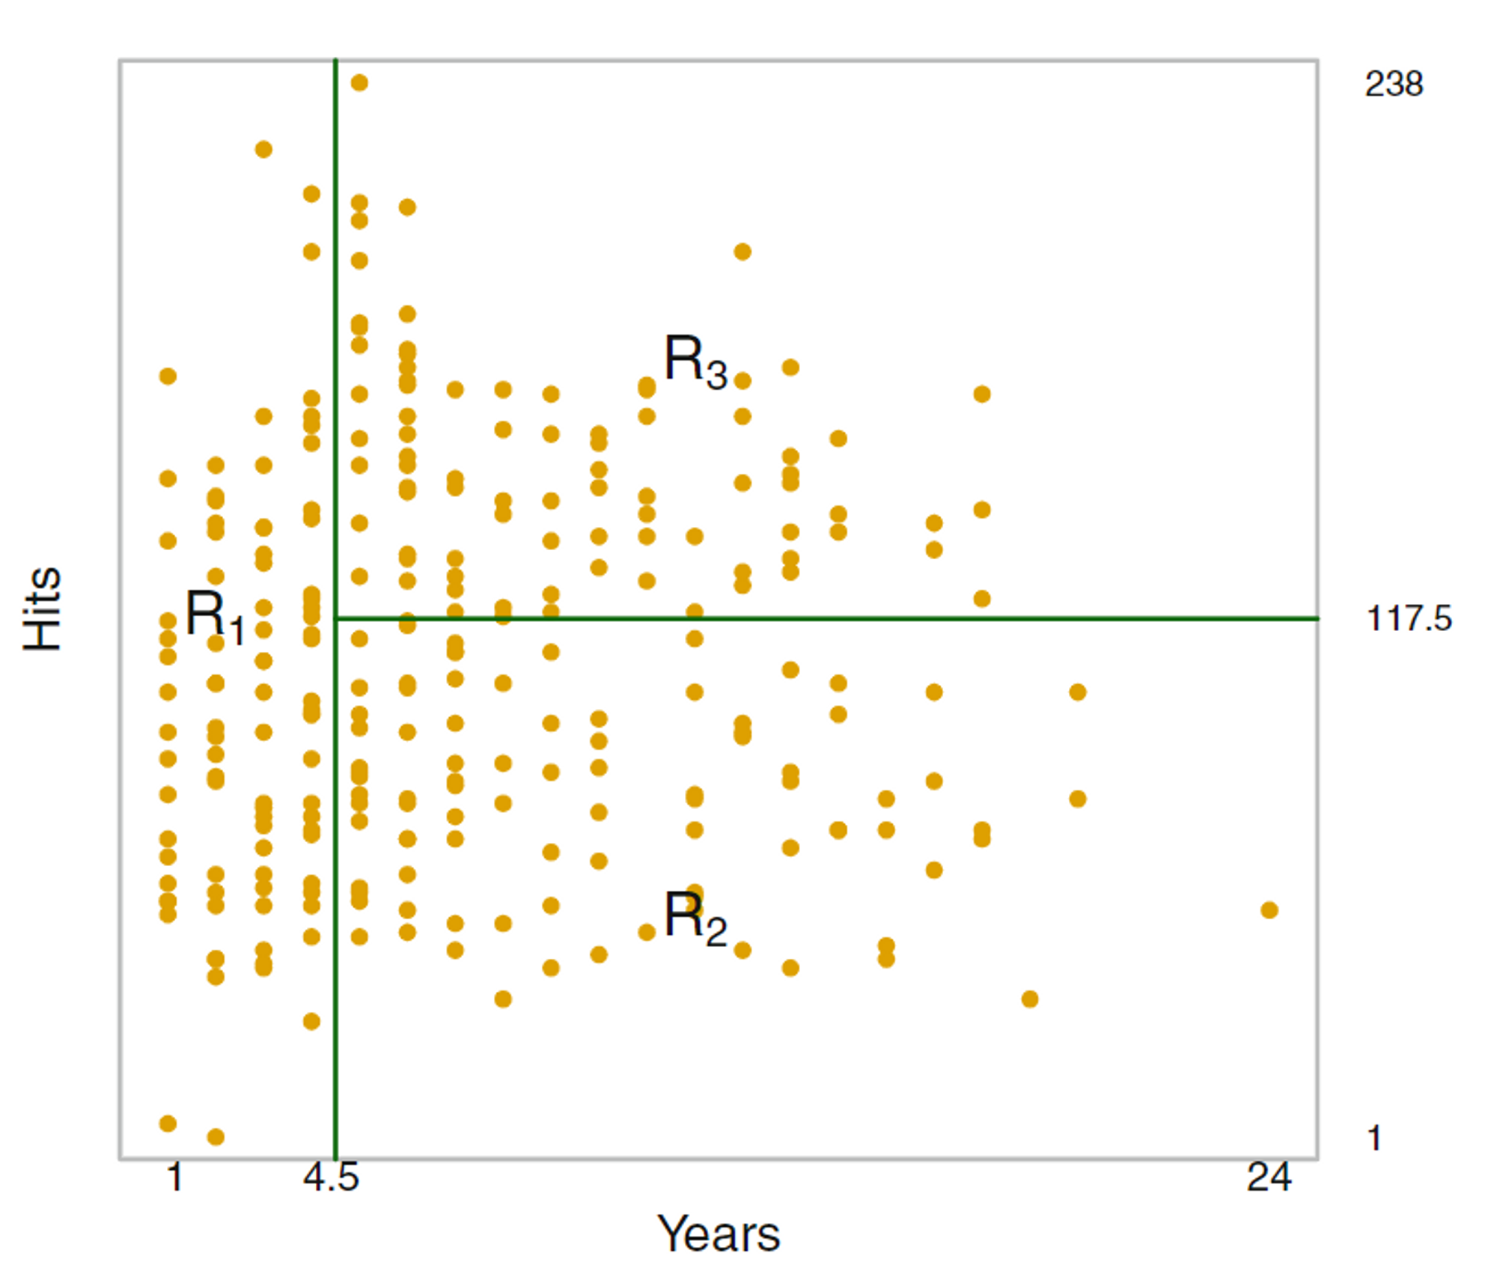
Baseball

Slide 41
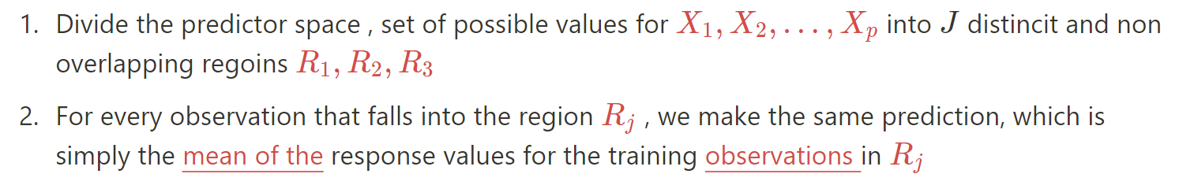
We now discuss the process of building a regression tree. Roughly speaking, there are two steps
Baseball

Slide 42
In the example, there are two regions R1 and R2. Observations in R1 get a prediction of 10, while those in R2 get a prediction of 20.
The regions can have any shape in theory, but for simplicity and interpretability, the predictor space is divided into rectangular regions.
The goal is to find rectangular regions that minimize the residual sum of squares (RSS), which measures how close the predictions are to the actual responses.
By minimizing the RSS, the tree finds the partition of the predictor space that results in the most homogeneous regions in terms of the response variable.
At each split or node in the tree, the predictors and split points are chosen to maximize the decrease in RSS (or increase in homogeneity).
Baseball

Slide 43
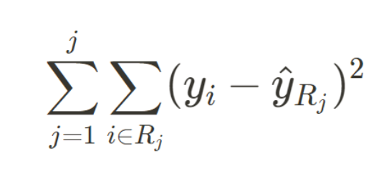
RSS
Residual(e) : difference between an observed value and the predicted value of a variable.
RSS = e_1^2 + e_2^2+ e_3^2+…+ e_n^2
The goal is to find rectangular regions that minimize the residual sum of squares (RSS), which measures how close the predictions are to the actual responses.
Ideal : put all possible partitions of the feature space into regions would be considered to minimize the RSS.
However, this is computationally infeasible, so a top-down, greedy approach called recursive binary splitting is used.
Baseball

Slide 44
RSS
Residual(e) : difference between an observed value and the predicted value of a variable.
RSS = e_1^2 + e_2^2+ e_3^2+…+ e_n^2
The goal is to find rectangular regions that minimize the residual sum of squares (RSS), which measures how close the predictions are to the actual responses.
Ideal : put all possible partitions of the feature space into regions would be considered to minimize the RSS.
However, this is computationally infeasible, so a top-down, greedy approach called recursive binary splitting is used.
Baseball

Slide 45
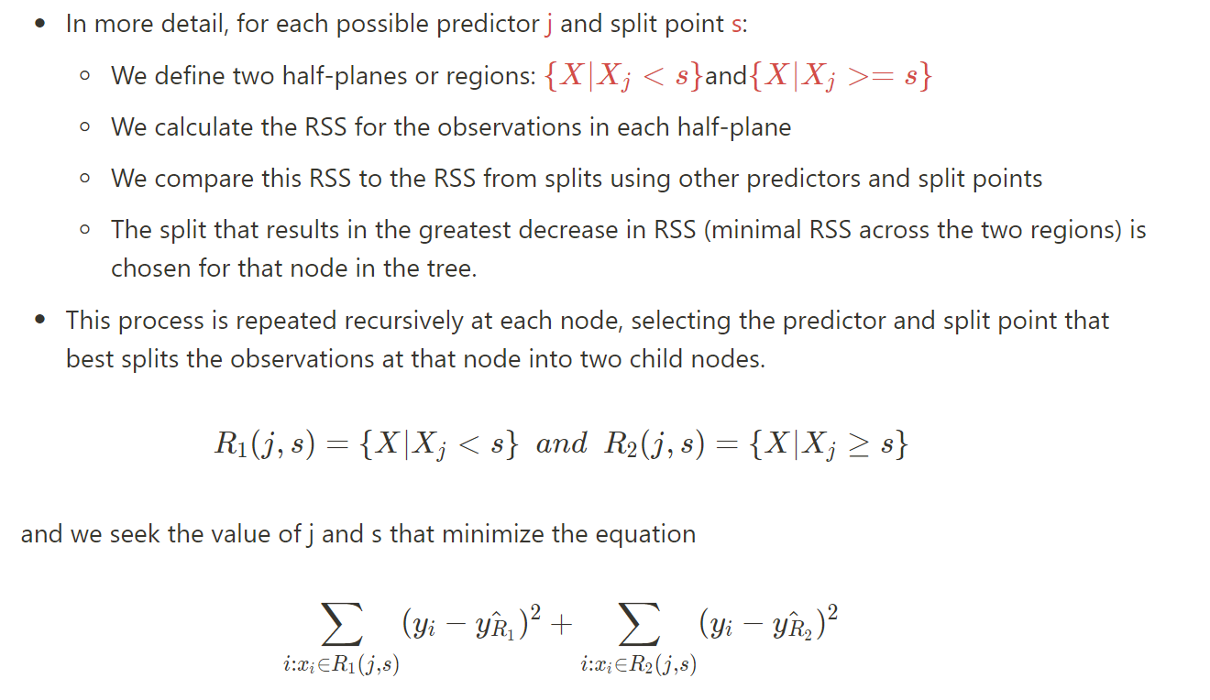

Slide 46
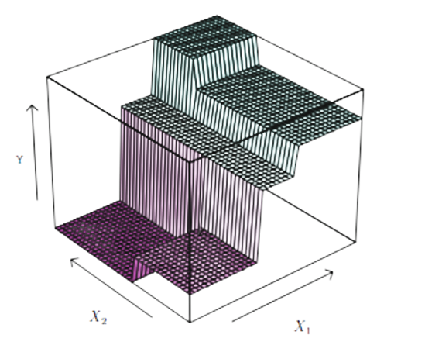
Tree in 3 predictive variable space

Slide 47

Tree pruning

Slide 48
The tree generated by the recursive splitting process may perform well on the training data but poorly on new test data due to overfitting.
This is because the tree can become too complex, leading to high variance.
A simpler tree with fewer splits (regions) may have lower variance and better interpretability, at the cost of some bias.
A good approach is to limit the size of the tree directly, for example by setting a maximum tree depth or number of terminal nodes. (Pre Pruning)
This balances the bias-variance tradeoff by controlling the complexity of the tree to avoid underfitting and overfitting

Slide 49
Growing a large tree and then pruning it back is a better strategy than limiting the number of splits during tree growth.(Post Pruning)
The goal is to select a subtree that minimizes the test error rate.
cost complexity pruning is used to select a sequence of subtrees indexed by a tuning parameter α. This sequence spans the range from the largest tree to the smallest tree with one terminal node.
For a given value of α, cost complexity pruning CCP selects the subtree that:
Minimizes the empirical risk (the training error rate)
Has the smallest number of terminal nodes among all subtrees with the same empirical risk
By varying α, a sequence of increasingly pruned subtrees is obtained.
The subtree with the smallest estimated test error, based on cross-validation or a validation set, is then selected as the final tree model.
In this way, cost complexity pruning provides a systematic approach to selecting a subtree that balances bias and variance for optimal test set performance

Slide 50
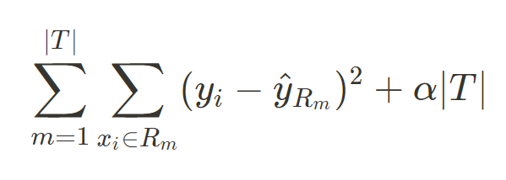
Cost complexity pruning selects subtrees that minimize the following quantity:
Training error + α * Number of terminal nodes
For each value of α there corresponds a subtree T ⊂T_0 such that

Slide 51
Cost complexity pruning selects subtrees that minimize the following quantity:
Training error + α * Number of terminal nodes
The parameter α controls the trade-off between complexity and training error.
When α = 0, the subtree with the lowest training error is selected (the full tree T_0).
As α increases, subtrees with fewer terminal nodes (smaller size) are favored to control for complexity.
Increasing α in a nested fashion prunes branches from the tree in a predictable way.
This produces a sequence of subtrees indexed by α, ranging from the full tree to the tree with one terminal node.

Slide 52
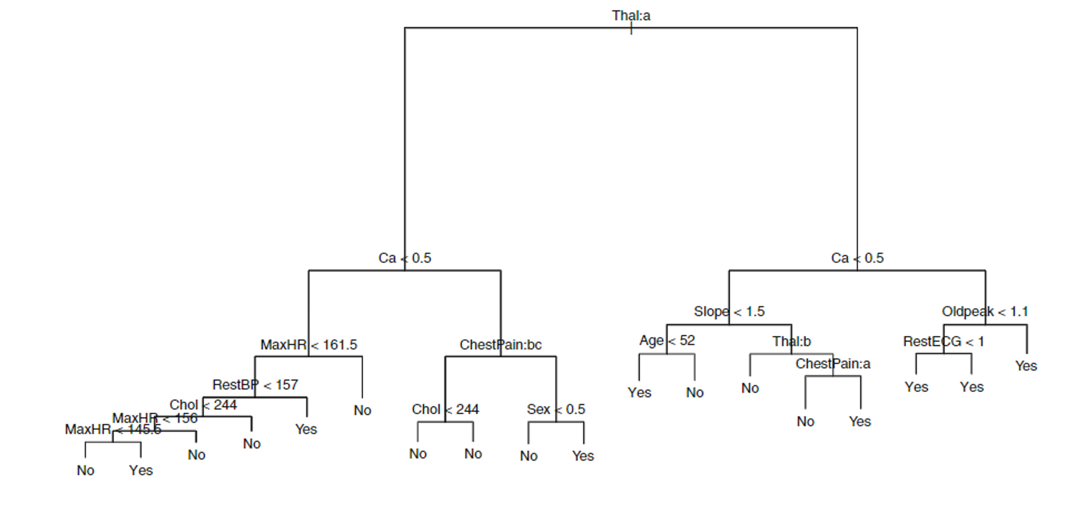

Slide 53
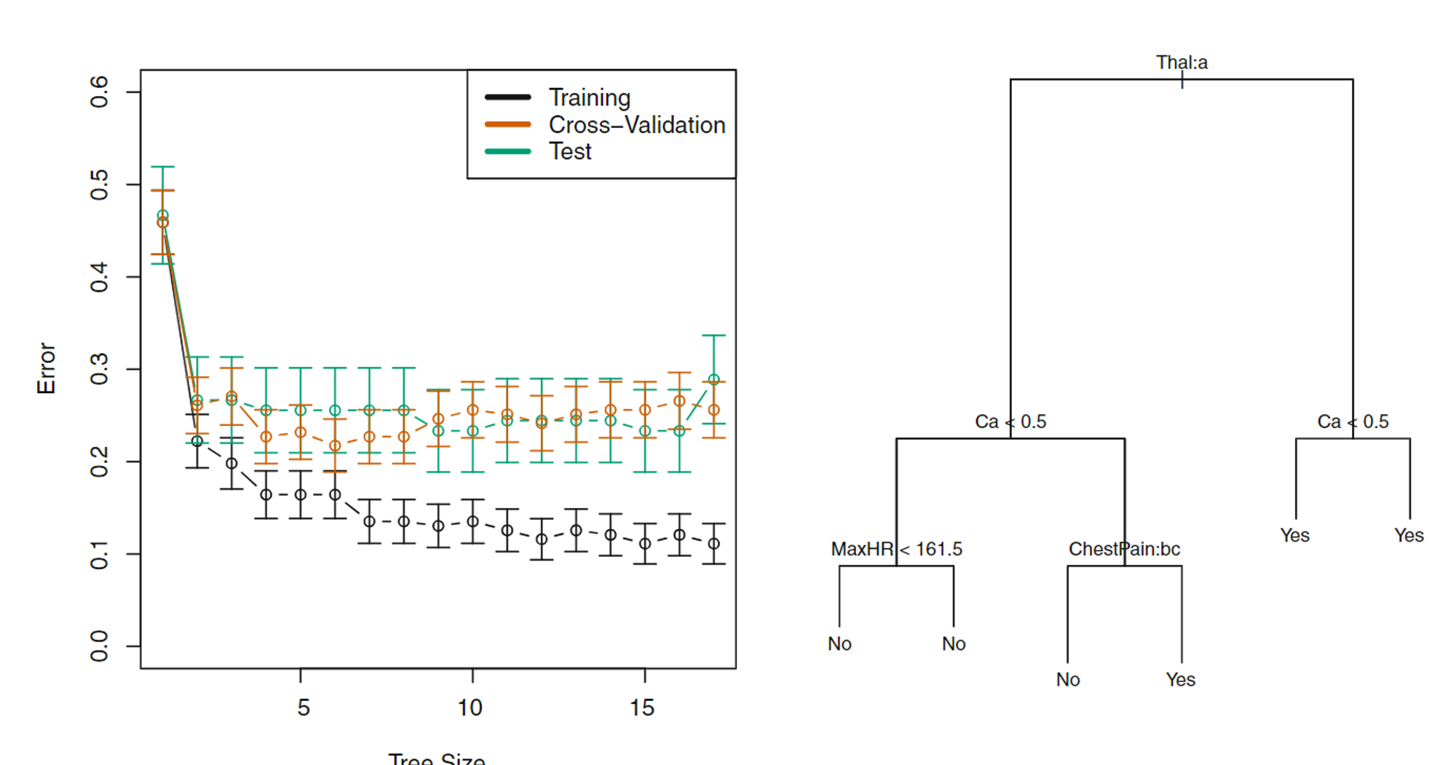






Slide 54

Thank You

Slide 55

See 👀
http://www.r2d3.us/visual-intro-to-machine-learning-part-1/
http://www.r2d3.us/visual-intro-to-machine-learning-part-2/

Slide 56
References
http://www.r2d3.us/visual-intro-to-machine-learning-part-1/
http://www.r2d3.us/visual-intro-to-machine-learning-part-2/
https://hossam-ahmed.notion.site/8-Tree-based-Model-c3a1186914ed40f7b4298dd5493f3fb3?pvs=4
https://hossam-ahmed.notion.site/Entropy-Information-Gain-Gini-Index-1fbaf1424fe8495f91b68d11a071a930?pvs=4
https://en.wikipedia.org/wiki/Decision_tree_learning
Book: statistical learning

